Slide 1



KONGU ENGINEERING COLLEGE
PERUNDURAI ERODE-638060
DEPARTMENT OF MASTER OF COMPUTER APPLICATIONS
EFFICIENT ATTENDANCE TRACKING USING
ON_SPOT FACIAL RECOGNITION SYSTEM
TEAM LEAD:
Thanusri MV
(24MCR115)
TEAM MEMBERS:
Nandhaprabhu R
(24MCR072)
Selva Sahayam Jeniston s
(24MCR096)
TEAM MENTOR WITH DESIGNATION AND DEPARTMENT:
Mr.S.Hemalatha
(Assistant Professor)
(MCA)

Slide 2


Abstract
Traditional attendance systems, such as manual roll calls and card-based methods, face significant challenges like inefficiency, human error, and susceptibility to misuse. To address these issues, the proposed "Efficient Attendance Tracking Using On-Spot Facial Recognition" system leverages real-time image capture and facial recognition technology.
This mobile-based platform ensures accurate and automated attendance marking while functioning seamlessly in both online and offline modes. With features like instant notifications, real-time verification, and secure cloud storage, it enhances efficiency, accuracy, and security. By eliminating manual errors and proxy attendance risks, this scalable and user-friendly system offers a modern solution for educational institutions.

Slide 3
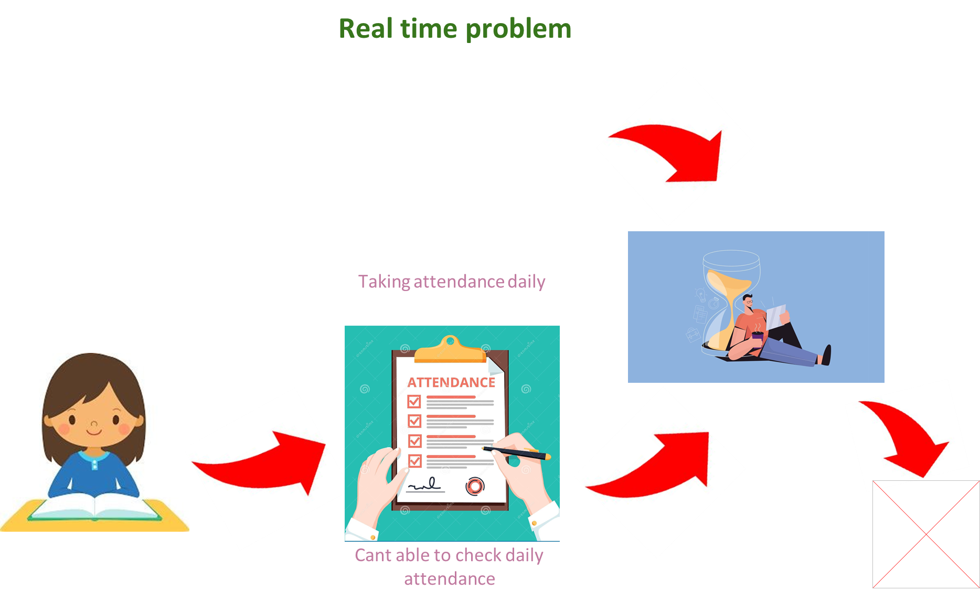



Real time problem

Slide 4
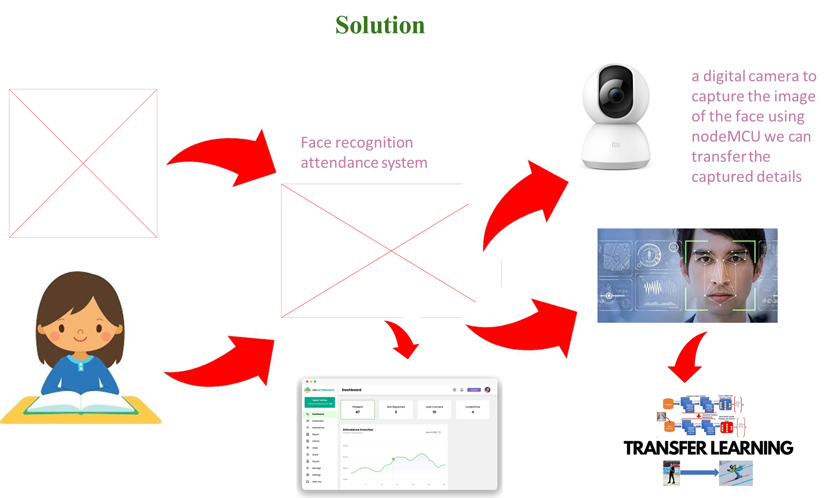
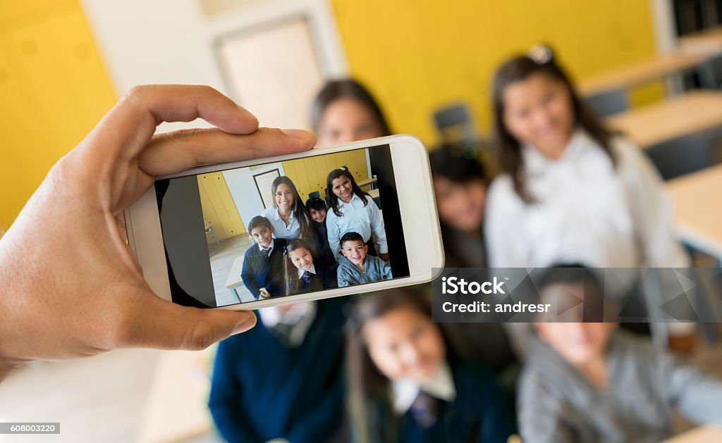


Solution

Slide 5

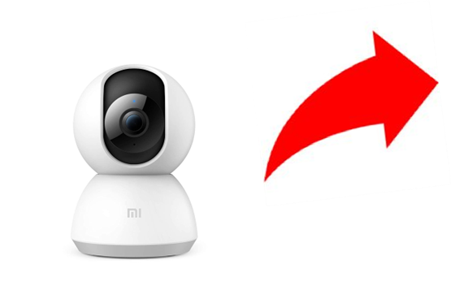
Working
A smart phone to capture the image of the face by taking photos of the all students in the class and process the given photos and provide attendance for all students.
Taken pic is send to the pretrained model which can be used to learn your images and adapt to the system well, it is futuristic. Transfer learning is the system which is used for machine learning. Few photos of the students is needed for initial training of the model.

Slide 6
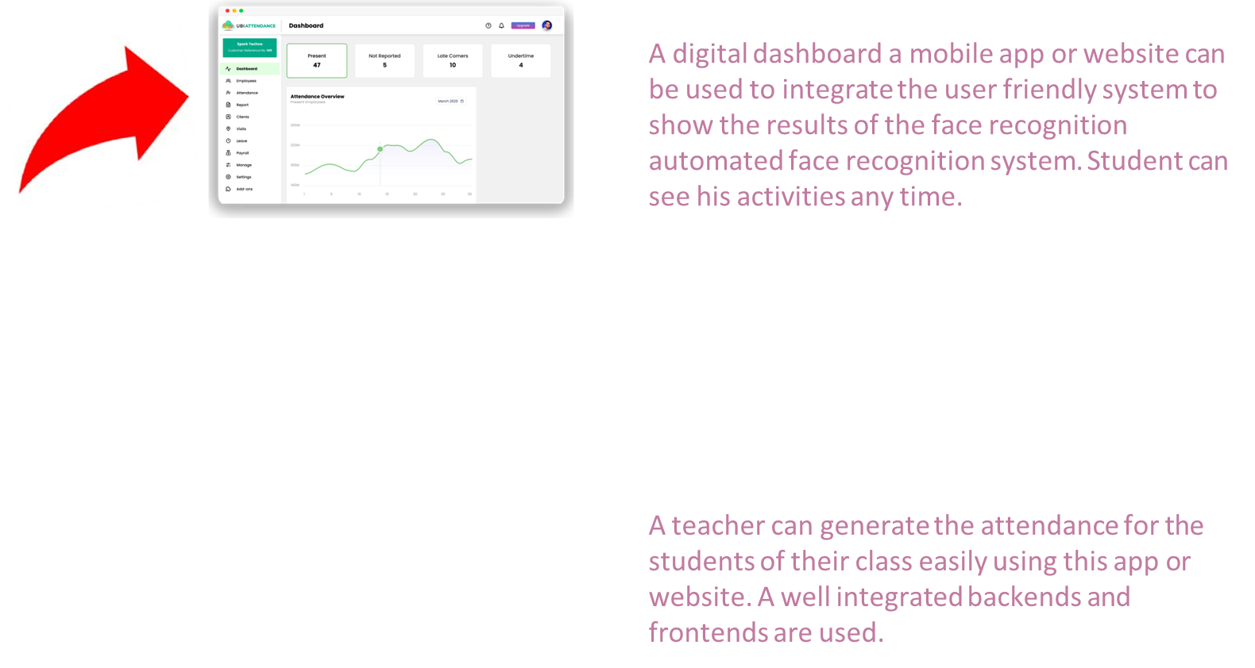
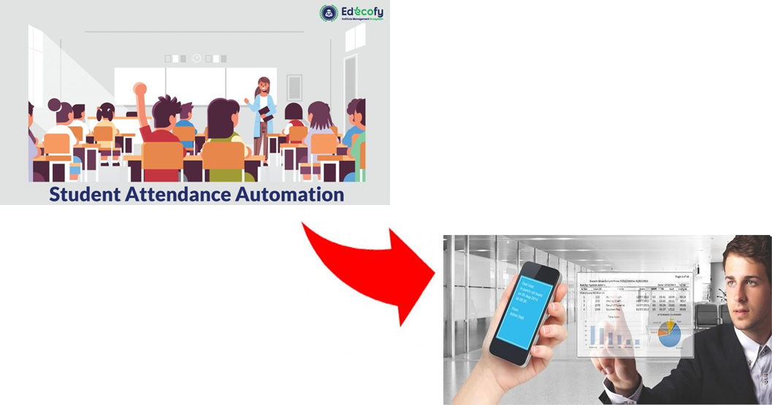

Slide 7





Modules
Registration
Camera
Attendance Status
Attendance report
Profile

Slide 8
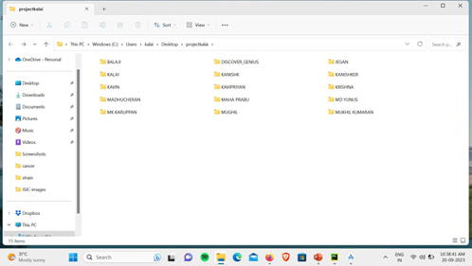
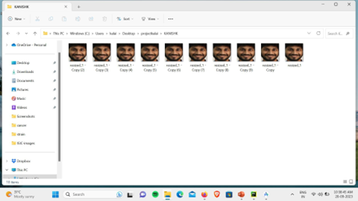
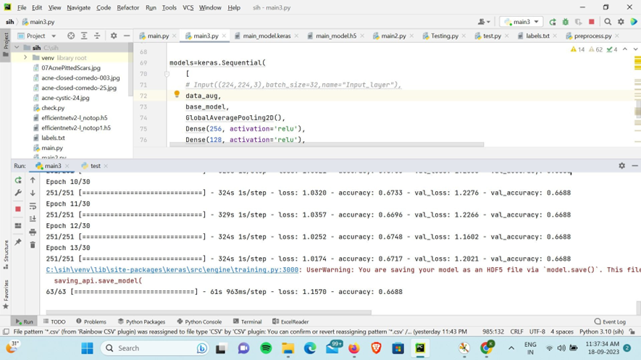
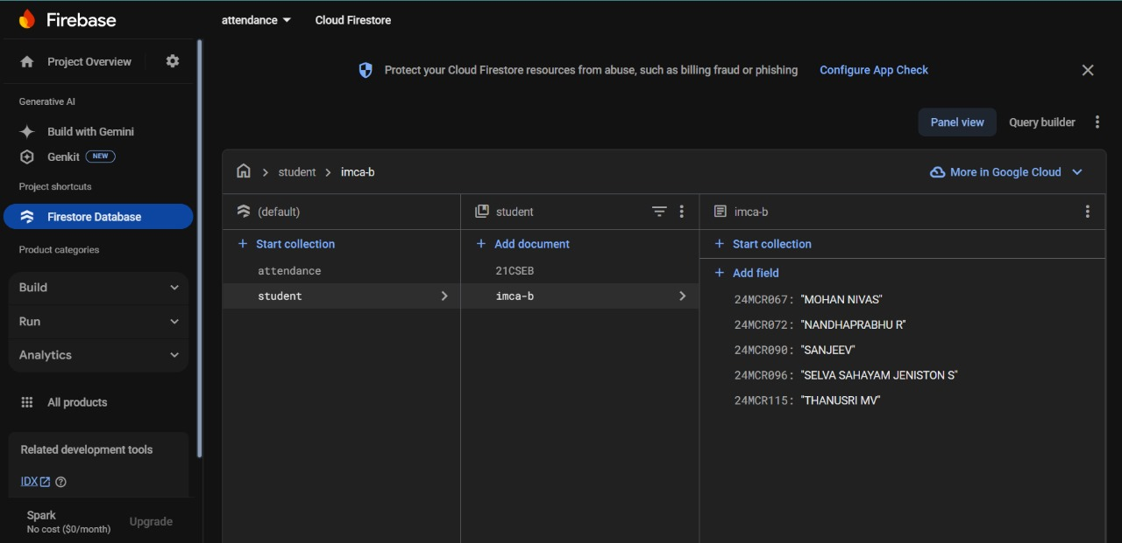
7
Training the Model and Database
Firebase as database
This is the we are using the picture for training the model. We are using transfer learning for this process for 06 members in our class.

Slide 9
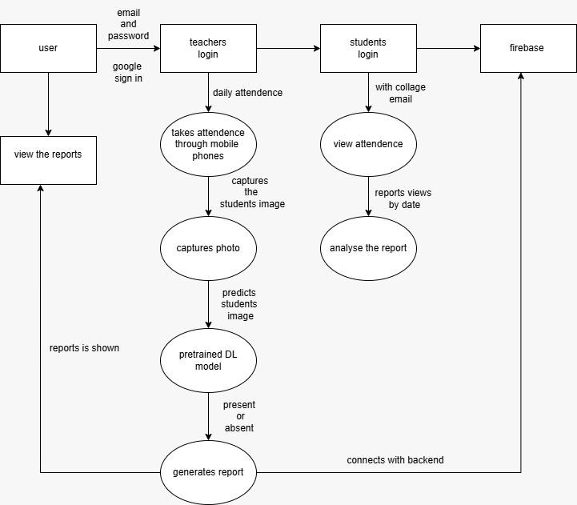
Data Flow Diagram

Slide 10
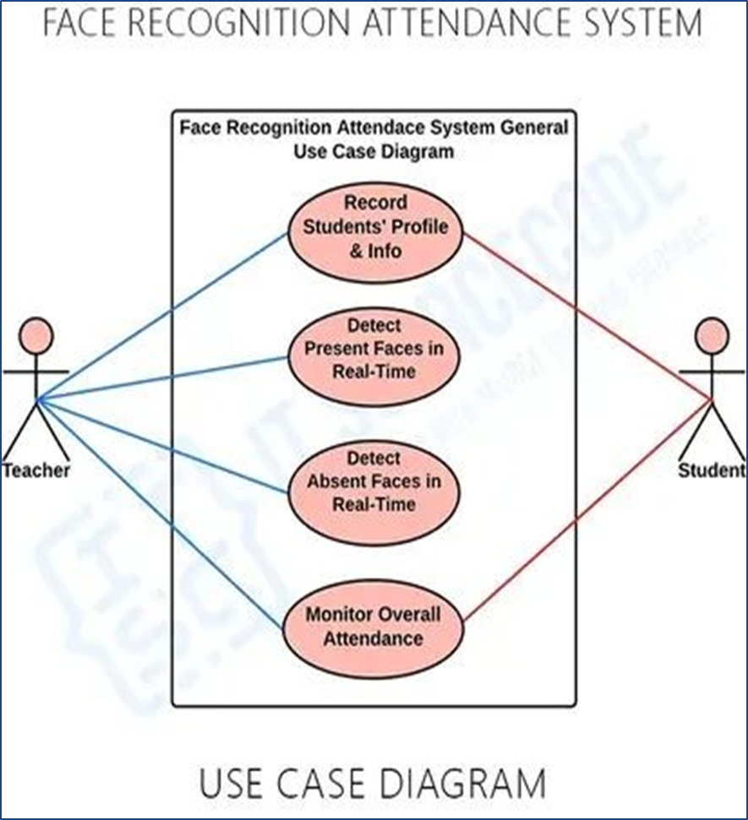

Slide 11




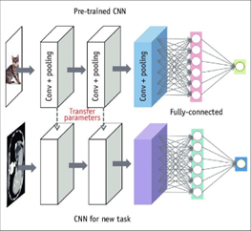
Technology stack

Slide 12
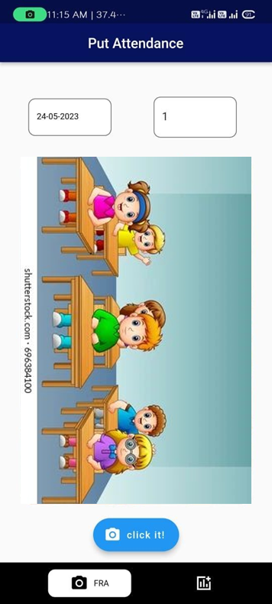
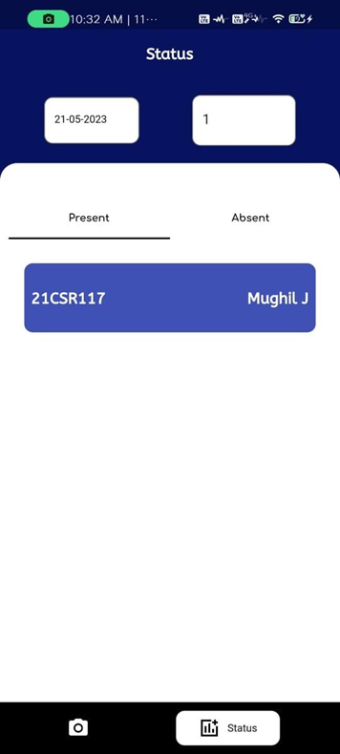
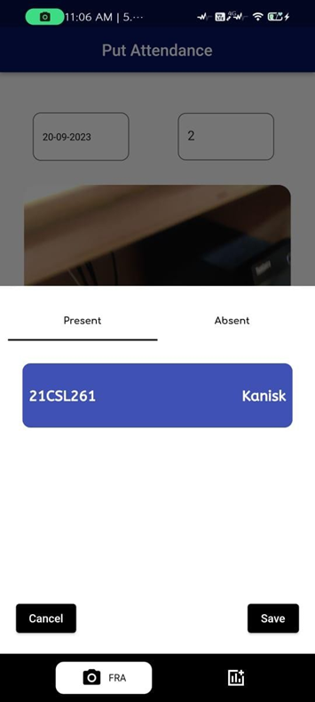
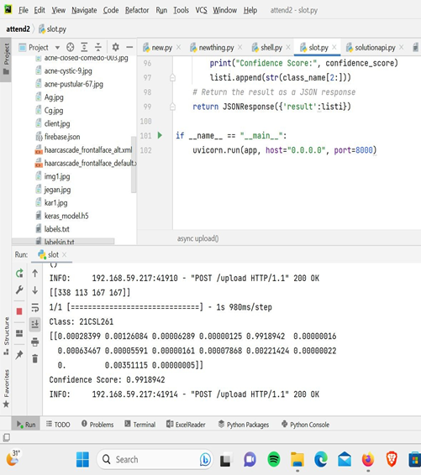
Output
Home page
Status page
Recognized page
FastAPI local server

Slide 13
Final Analysis
Student attendance management systems are not going to look the same again.
Digital touch-based visitor management systems and fingerprint biometric systems for authentication are soon going to be replaced by touchless facial recognition technology.
The day-to-day operational challenges that businesses and organizations across sectors face.

Slide 14


